Slide 1

DS809 - Industrial Inputs Price Index Modelling
Nate Thomas

Slide 2
Introduction and Overview
Industrial Inputs Price Index (IIPI): from 1980 through 2016.
IIPI: by the International Monetary Fund (IMF) in the IMF Primary Commodity Prices Report (IMF Primary Commodity Prices, 2021).
Excludes energy commodities (Coal, Natural Gas, Spot Crude, Propane)
Includes:
agricultural raw materials (Cotton, Hides, Rubber, Timber, Wool)
metals (Aluminum, Cobalt, Copper, Iron Ore, Lead, Molybdenum, Nickel, Tin, Uranium, and Zinc)
precious metals (Gold, Palladium, Platinum, Silver).
A relative value indicator (here indexed to 2005 = 100)

Slide 3
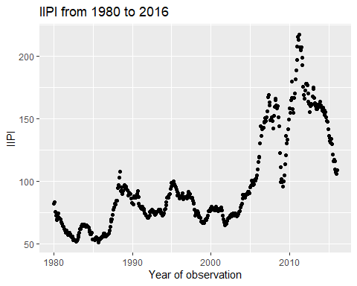
Data Set Collection
Predictive Dynamics in Commodity Prices (Gargano & Timmerman, 2012) is a loose framework for select variables therein.
A. IIPI (Aliyev, 2020), Dependent Variable and Date index. tags: IIPI, Date_form. This dataset defined the time frame of interest (1980-02-01 to 2016-02-01). All other datasets were selected contingent upon their inclusion of this timeframe.
Plot of IIPI as a function of time

Slide 4
Data Set Collection
B. 13 Week Treasury Bill (US Trade - Statistics & Facts, 2021), Independent Variable. tag: TBillClose.
C. US Real GDP (Real Gross Domestic Product (GDPC1) | FRED | St. Louis Fed, n.d.). tag: GDP
D. US Inflation (US Inflation Rate by Month, n.d.). tag: InfRate
E. Industrial Production (Industrial Production: Total Index (INDPRO)| FRED | St. Louis Fed, n.d.). tag: IndPro
F. Money Supply M2, (BOARD OF GOVERNORS of the FEDERAL RESERVE SYSTEM, 2021). tag: M2
G. US Unemployment, (Employment and Unemployment). tag: UnempRate
H. Recession, (Dates of U.S. Recessions as Inferred by GDP-based Recession Indicator). tag : Recession
United States’ trade accounts for the largest percentage (13.5%) of total import trade worldwide (US Trade - Statistics & Facts, 2021).

Slide 5
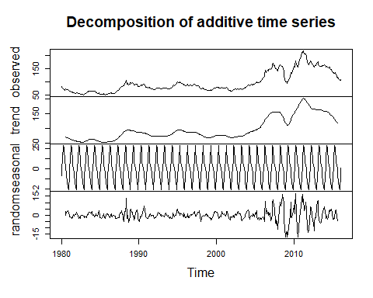
Visual Inspection of the Data
The data was decomposed using native R stats package to visually assess the potential time series decomposition of IIPI.
The scale of the seasonal component is misleading, and is found to be insignificant in subsequent analysis to follow. There is also very clearly non-constant variance in the series as seen in the randomness plot.

Slide 6
Project Goal
The goal of any time series analysis is to achieve white noise residuals. By achieving white noise residuals one can conclude that a model has captured the non-stochastic behavior of the modeled series.

Slide 7
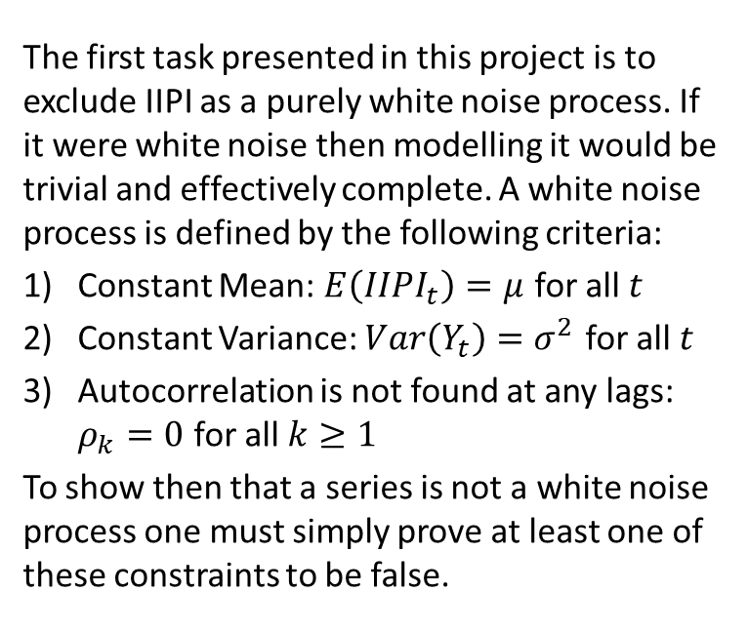
Excluding White Noise Criteria
The first task presented in this project is to exclude IIPI as a purely white noise process. If it were white noise then modelling it would be trivial and effectively complete. A white noise process is defined by the following criteria:
Constant Mean: $E\left(IIPI_{t}\right)=μ$ for all $t$
Constant Variance: $Var\left(Y_{t}\right)=σ^{2}$ for all $t$
Autocorrelation is not found at any lags: $ρ_{k}=0$ for all $k≥1$
To show then that a series is not a white noise process one must simply prove at least one of these constraints to be false.

Slide 8
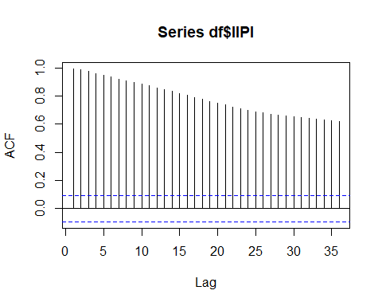

IIPI White Noise Rejection
The Box-Pierce Test is used to confirm the existence of autocorrelation up to a defined maximum lag value (here 36 months):
##
## Box-Pierce test
##
## data: df$IIPI
## X-squared = 9809, df = 36, p-value < 2.2e-16
$H_{0}$: All autocorrelctions are zero (0), $H_{a}$: At least one (1) autocorrelation is not zero (0)
The test indicates one can safely reject the null hypothesis ($H_{0}$) - such that at least one (1) autocorrleation is not zero.
This is also seen through visual inspection of the autocorrelation function (ACF):
The series is non-stationary as indicated by the slow decay in autocorrelation.
Based on this, the series is not a white noise process.

Slide 9
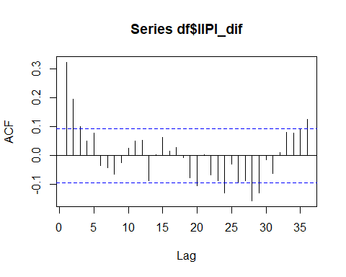

IIPI First Difference White Noise Process Rejection
The first difference is also reviewed to ensure it is not white noise.
Again, the Box-Pierce Test is used to confirm the existence of autocorrelation up to a defined maximum lag value (here 36 months) for the first difference:
##
## Box-Pierce test
##
## data: df$IIPI_dif
## X-squared = 143.33, df = 36, p-value = 9.548e-15
$H_{0}$: All autocorrelctions are zero (0), $H_{a}$: At least one (1) autocorrelation is not zero (0)
The test indicates one can safely reject the null hypothesis (H0) - such that at least one (1) autocorrleation is not zero in the first difference of the series.
This is also seen through visual inspection of the ACF chart:
The first difference of IIPI is stationary as can be seen in the fast decay in autocorrelation.
Not white noise due to a variety of significant autocorrelations (those seen beyond the dotted blue line).

Slide 10
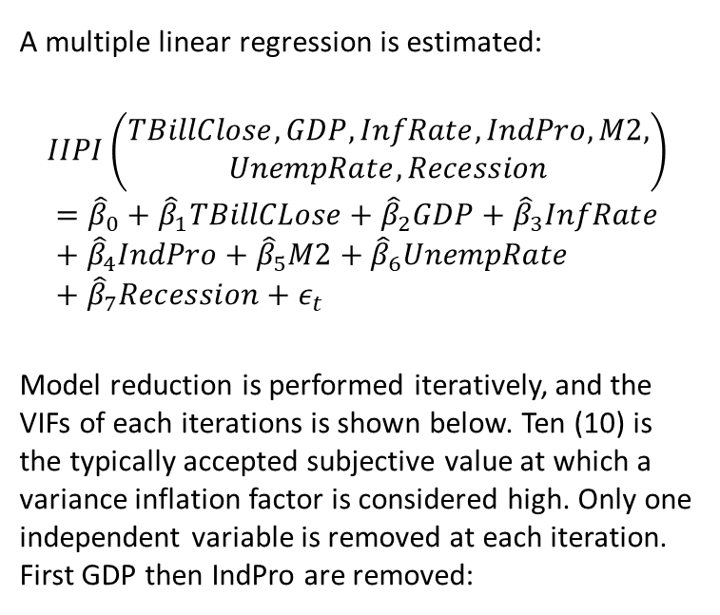
Regression Model
A multiple linear regression is estimated:
$$IIPI\left(\begin{aligned}TBillClose,GDP,InfRate,IndPro,M2, \\ UnempRate,Recession\end{aligned}\right)$$
$$={\hat{β}}_{0}+{\hat{β}}_{1}TBillCLose+{\hat{β}}_{2}GDP+{\hat{β}}_{3}InfRate+{\hat{β}}_{4}IndPro+{\hat{β}}_{5}M2+{\hat{β}}_{6}UnempRate+{\hat{β}}_{7}Recession+ε_{t}$$
Model reduction is performed iteratively, and the VIFs of each iterations is shown below. Ten (10) is the typically accepted subjective value at which a variance inflation factor is considered high. Only one independent variable is removed at each iteration. First GDP then IndPro are removed:

Slide 11
Regression Model VIF Iteration 1:
 | x
TBillClose | 6.449018
GDP | 204.551481
InfRate | 2.595684
IndPro | 106.137107
M2 | 27.685682
UnempRate | 3.117667
Recession | 1.214842

Slide 12
Regression Model VIF Iteration 2:
 | x
TBillClose | 5.516964
InfRate | 2.590142
IndPro | 11.576634
M2 | 9.732960
UnempRate | 2.745397
Recession | 1.195094

Slide 13

Regression Model Iteration 3:
 | x
TBillClose | 5.201603
InfRate | 2.590000
M2 | 3.246820
UnempRate | 1.034536
Recession | 1.186641
The VIFs of the variable reduced model are shown below. This model is retained for subsequent analysis.
Due to the multicollinearities the regression model has been reduced to the following:
$IIPI\left(TBillClose,InfRate,M2,UnempRate,Recession\right)={\hat{β}}_{0}+{\hat{β}}_{1}TBillCLose+{\hat{β}}_{3}InfRate+{\hat{β}}_{5}M2+{\hat{β}}_{6}UnempRate+{\hat{β}}_{7}Recession+ε_{t}$

Slide 14
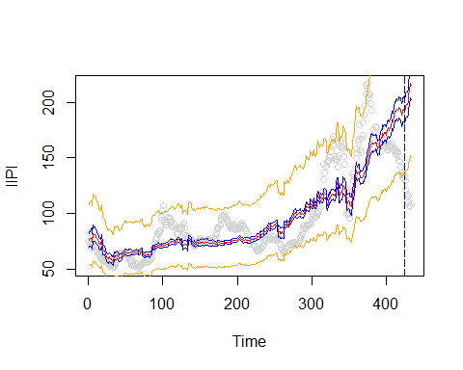
Regression Model Fit Plot
The model is fit to the first 423 observations, then ten test predictions are estimated (after the blue dotted line)

Slide 15
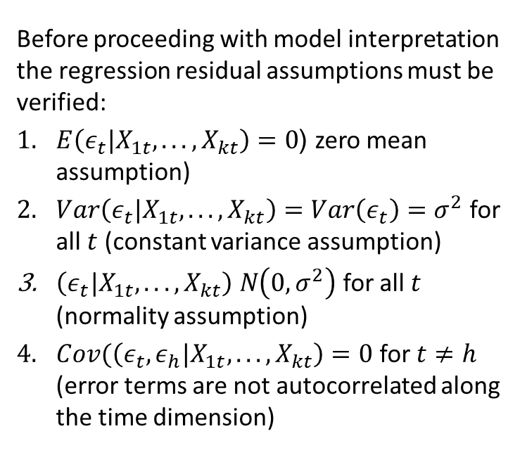
Regression Residual Assumptions
Before proceeding with model interpretation the regression residual assumptions must be verified:
$E\left(ε_{t}|X_{1t},...,X_{kt}\right)=0$ (zero mean assumption)
$Var\left(ε_{t}|X_{1t},...,X_{kt}\right)=Var\left(ε_{t}\right)=σ^{2}$ for all $t$ (constant variance assumption)
$\left(ε_{t}|X_{1t},...,X_{kt}\right) N\left(0,σ^{2}\right)$ for all $t$ (normality assumption)
$Cov(\left(ε_{t},ε_{h}|X_{1t},...,X_{kt}\right)=0$ for $t≠h$ (error terms are not autocorrelated along the time dimension)

Slide 16
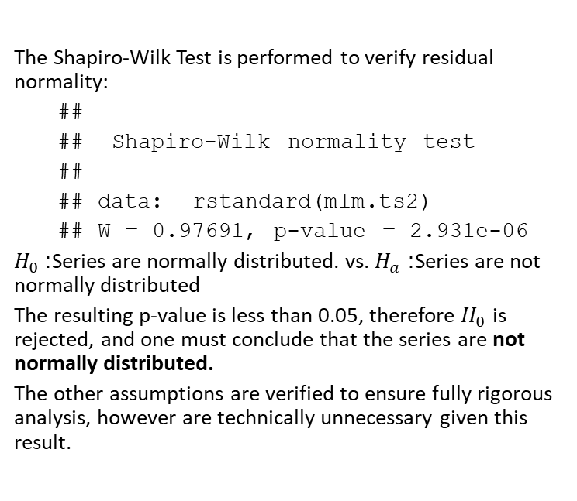
Regression Residual Normality
The Shapiro-Wilk Test is performed to verify residual normality:
##
## Shapiro-Wilk normality test
##
## data: rstandard(mlm.ts2)
## W = 0.97691, p-value = 2.931e-06
$H_{0}$: Series are normally distributed. vs. $H_{a}$: Series are not normally distributed
The resulting p-value is less than 0.05, therefore $H_{0}$ is rejected, and one must conclude that the series are not normally distributed.
The other assumptions are verified to ensure fully rigorous analysis, however are technically unnecessary given this result.

Slide 17
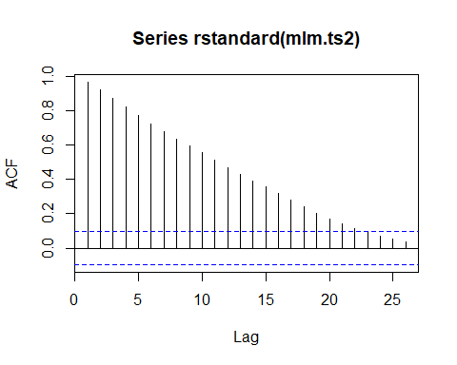

Regression Residual Autocorrelation
The Box-Pierce test is performed to identify if the residuals are autocorrelated:
##
## Box-Pierce test
##
## data: rstandard(mlm.ts2)
## X-squared = 3032.8, df = 36, p-value < 2.2e-16
$H_{0}$: $ρ_{1}=ρ_{2}=ρ_{k}=0$ (all autocorrelations are zero). vs. $H_{a}$: at least one $ρ_{k}≠0$ (at least one autocorrealtion is not zero)
The residuals are highly autocorrelated and non-stationary. This model can be improved greatly, as there still appears to be time series information not captured in this model.
The resulting p-value is less than 0.05, therefore $H_{0}$ is rejected, and one must conclude that at least one lag value returns a statistically significant autocorrelation, as seen below:

Slide 18
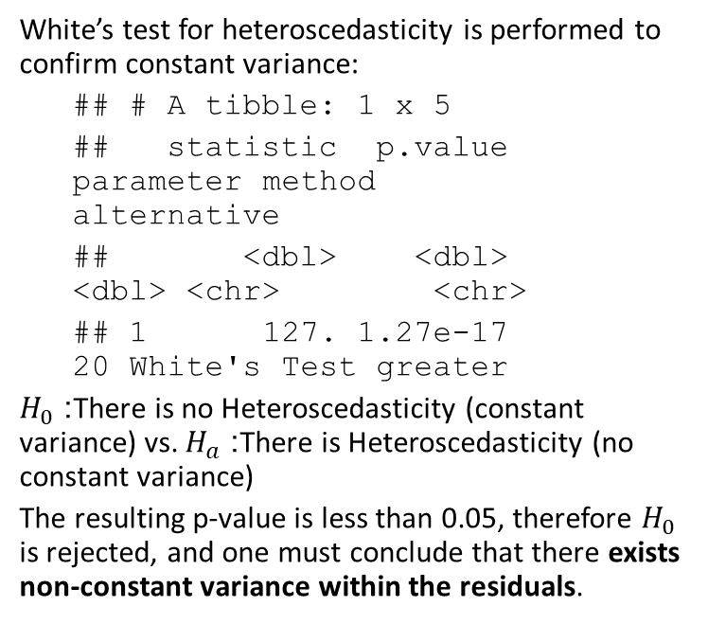
Regression Constant Variance
White’s test for heteroscedasticity is performed to confirm constant variance:
## # A tibble: 1 x 5
## statistic p.value parameter method alternative
## <dbl> <dbl> <dbl> <chr> <chr>
## 1 127. 1.27e-17 20 White's Test greater
$H_{0}$: There is no Heteroscedasticity (constant variance) vs. $H_{a}$: There is Heteroscedasticity (no constant variance)
The resulting p-value is less than 0.05, therefore $H_{0}$ is rejected, and one must conclude that there exists non-constant variance within the residuals.

Slide 19
Regression Residual Summary
All the residual assumptions failed for this initial regression. The residuals are not white noise. Subsequent methods and analysis will be required to extract inherent non-stochastic information presented in the IIPI series.

Slide 20
Regression Model Summary
##
## Call:
## lm(formula = IIPI ~ ., data = df.ts.modelset.train %>% select(-c(Date_form,
## GDP, IndPro)))
##
## Residuals:
## Min 1Q Median 3Q Max
## -46.572 -12.036 -2.934 11.558 64.760
##
## Coefficients:
## Estimate Std. Error t value Pr(>|t|)
## (Intercept) -1.568e-01 5.909e+00 -0.027 0.979
## TBillClose 3.528e-01 5.830e-01 0.605 0.545
## InfRate 3.607e+00 5.887e-01 6.128 2.06e-09 ***
## M2 1.384e-02 5.912e-04 23.416 < 2e-16 ***
## UnempRate 2.254e+00 5.697e-01 3.956 8.95e-05 ***
## Recession -1.210e+01 2.933e+00 -4.124 4.49e-05 ***
## ---
## Signif. codes: 0 '***' 0.001 '**' 0.01 '*' 0.05 '.' 0.1 ' ' 1
##
## Residual standard error: 18.77 on 417 degrees of freedom
## Multiple R-squared: 0.7733, Adjusted R-squared: 0.7706
## F-statistic: 284.5 on 5 and 417 DF, p-value: < 2.2e-16

Slide 21
Regression Model Summary
If the residual assumptions were found to be true one could interpret the coefficients displayed above. All p-values indicate significance, except the intercept and TBillClose (though the residual distribution assumptions fail making interpretation dubious).
The expected value of IIPI at time zero (Feb, 1980) is -0.1567672.
The expected change in the value of IIPI, ceteris paribus, for each unit change in TBillClose is 0.3527733.
The expected change in the value of IIPI, ceteris paribus, for each unit change in InfRate is 3.6073808.
The expected change in the value of IIPI, ceteris paribus, for each unit change in M2 is 0.0138443.
The expected change in the value of IIPI, ceteris paribus, for each unit change in UnempRate is 2.2538474.
The expected change in the value of IIPI, ceteris paribus, for each unit change in Recession is -12.095765.

Slide 22
Deterministic Models

Slide 23
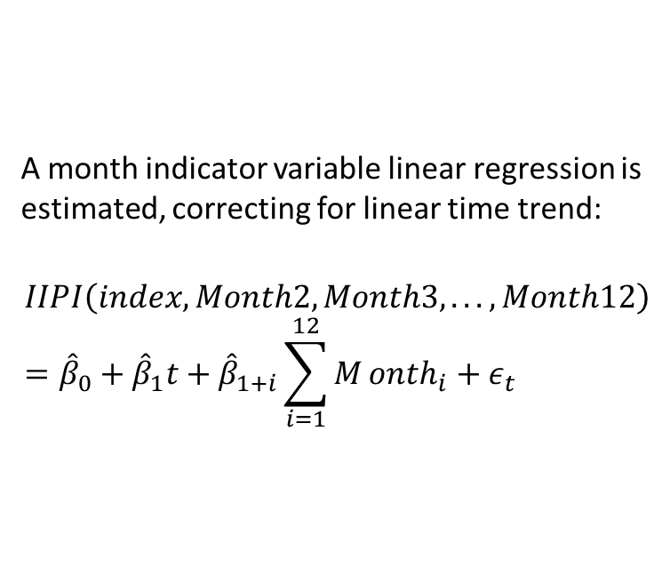
Indicator Variable Regression Model with Trend
A month indicator variable linear regression is estimated, correcting for linear time trend:
$$IIPI\left(index,Month2,Month3,...,Month12\right)={\hat{β}}_{0}+{\hat{β}}_{1}t+{\hat{β}}_{1+i}\sum_{i=1}^{12}{M}onth_{i}+ε_{t}$$

Slide 24
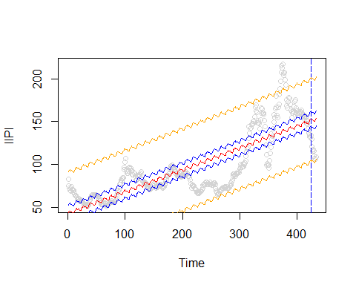
Indicator Variable Regression Model Fit Plot
Indicator Variable Regression

Slide 25
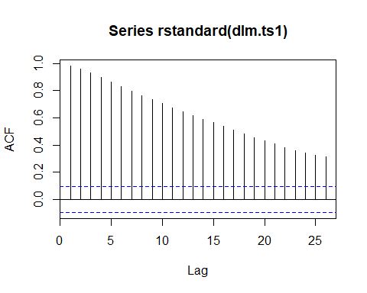
Indicator Variable Regression Residual Autocorrelation
The Box-Pierce test is performed to identify if the residuals are autocorrelated (see hypothesis definition above):
##
## Box-Pierce test
##
## data: rstandard(dlm.ts1)
## X-squared = 408.09, df = 1, p-value < 2.2e-16
Again, the residuals are highly autoccorrelated and non-stationary.

Slide 26
Indicator Variable Regression Model Summary
None of the month indicator variables are significant.
##
## Call:
## lm(formula = IIPI ~ index + Month, data = df.ts.modelset.deterministic.train)
##
## Residuals:
## Min 1Q Median 3Q Max
## -44.781 -15.685 0.234 16.182 77.000
##
## Coefficients:
## Estimate Std. Error t value Pr(>|t|)
## (Intercept) 41.489568 4.549852 9.119 <2e-16 ***
## index 0.255417 0.009554 26.735 <2e-16 ***
## Month2 1.782036 5.694805 0.313 0.754
## Month3 2.215359 5.694733 0.389 0.697
## Month4 3.329823 5.694677 0.585 0.559
## Month5 3.414111 5.735076 0.595 0.552
## Month6 1.947270 5.734957 0.340 0.734
## Month7 1.790995 5.734854 0.312 0.755
## Month8 1.596455 5.734766 0.278 0.781
## Month9 0.603795 5.734694 0.105 0.916
## Month10 -0.405964 5.734639 -0.071 0.944
## Month11 -0.857836 5.734599 -0.150 0.881
## Month12 -1.290996 5.734575 -0.225 0.822
## ---
## Signif. codes: 0 '***' 0.001 '**' 0.01 '*' 0.05 '.' 0.1 ' ' 1
##
## Residual standard error: 23.99 on 410 degrees of freedom
## Multiple R-squared: 0.6358, Adjusted R-squared: 0.6251
## F-statistic: 59.64 on 12 and 410 DF, p-value: < 2.2e-16

Slide 27
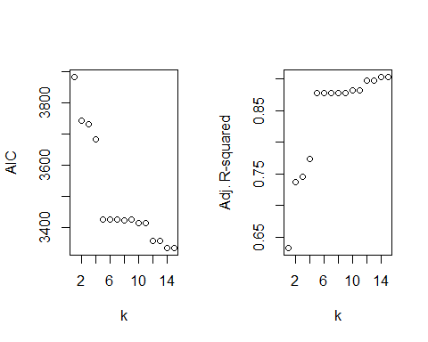

Polynomial Model
A polynomial linear regression is estimated:
$$IIPI\left(t\right)={\hat{β}}_{0}+{\hat{β}}_{1}t+{\hat{β}}_{2}t^{2}+...+{\hat{β}}_{k}t^{k}+ε_{t}$$
$k$ was found by assessment of the adjusted R-squared values and AIC values of prospective models.

Slide 28
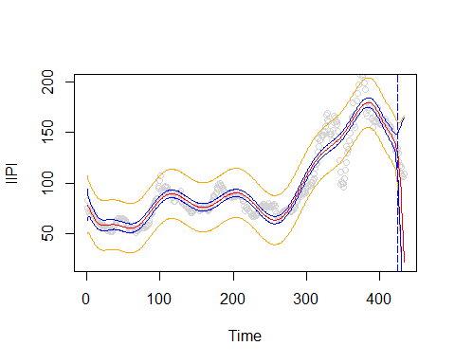
Polynomial Model Fit Plot
The model fits the data well in-sample, but performes poorly within the prediction region.
Polynomial Fit, k=14

Slide 29
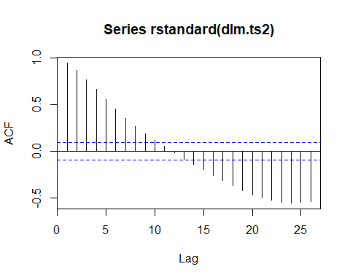

Polynomial Model Residual Autocorrelation
The Box-Pierce test is performed to identify if the residuals are autocorrelated (hypothesis outlined above):
##
## Box-Pierce test
##
## data: rstandard(dlm.ts2)
## X-squared = 380.01, df = 1, p-value < 2.2e-16
$H_{0}$ is rejected. Autocorrelation is present in the series.
Again, the residuals are highly autoccorrelated and non-stationary. More work is required to better capture the inherent information contained within the IIPI series.

Slide 30
Polynomial Model Model Summary
This model fits the in-sample data well but fails in the prediction region. While many of the coefficients in the model would be significant, the residuals are not white noise, therefore their interpretation is not rigorously permitted.
##
## Call:
## lm(formula = IIPI ~ poly(index, 14), data = df.ts.modelset.deterministic.train)
##
## Residuals:
## Min 1Q Median 3Q Max
## -52.714 -5.879 -0.781 5.149 41.701
##
## Coefficients:
## Estimate Std. Error t value Pr(>|t|)
## (Intercept) 96.8240 0.5942 162.948 < 2e-16 ***
## poly(index, 14)1 641.0526 12.2209 52.455 < 2e-16 ***
## poly(index, 14)2 259.1117 12.2209 21.202 < 2e-16 ***
## poly(index, 14)3 76.8761 12.2209 6.291 8.16e-10 ***
## poly(index, 14)4 -136.9970 12.2209 -11.210 < 2e-16 ***
## poly(index, 14)5 -257.6309 12.2209 -21.081 < 2e-16 ***
## poly(index, 14)6 -13.6410 12.2209 -1.116 0.2650
## poly(index, 14)7 22.0385 12.2209 1.803 0.0721 .
## poly(index, 14)8 24.5687 12.2209 2.010 0.0450 *
## poly(index, 14)9 -3.9927 12.2209 -0.327 0.7441
## poly(index, 14)10 -49.4098 12.2209 -4.043 6.31e-05 ***
## poly(index, 14)11 15.4381 12.2209 1.263 0.2072
## poly(index, 14)12 99.8887 12.2209 8.174 3.81e-15 ***
## poly(index, 14)13 -11.7975 12.2209 -0.965 0.3349
## poly(index, 14)14 -60.6462 12.2209 -4.963 1.02e-06 ***
## ---
## Signif. codes: 0 '***' 0.001 '**' 0.01 '*' 0.05 '.' 0.1 ' ' 1
##
## Residual standard error: 12.22 on 408 degrees of freedom
## Multiple R-squared: 0.9059, Adjusted R-squared: 0.9027
## F-statistic: 280.7 on 14 and 408 DF, p-value: < 2.2e-16

Slide 31
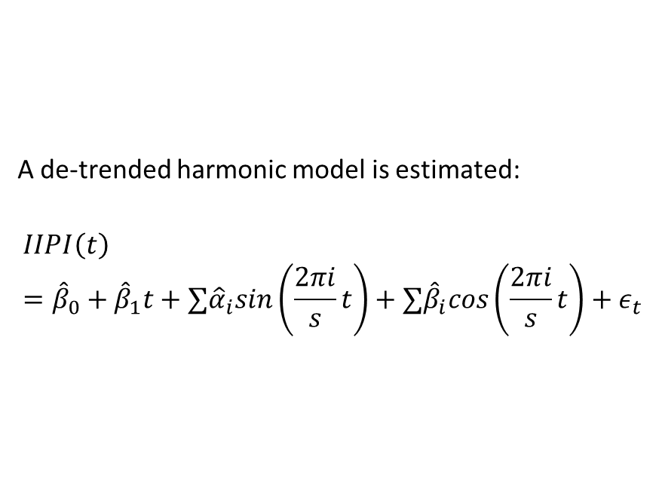
Harmonic Model
A de-trended harmonic model is estimated:
$$IIPI\left(t\right)={\hat{β}}_{0}+{\hat{β}}_{1}t+∑{\hat{α}}_{i}sin\left(\frac{2πi}{s}t\right)+∑{\hat{β}}_{i}cos\left(\frac{2πi}{s}t\right)+ε_{t}$$

Slide 32
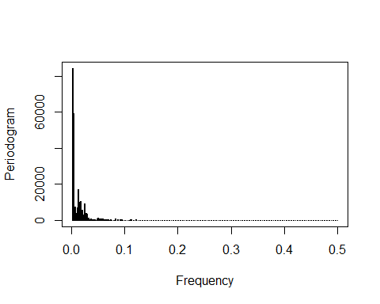
Harmonic Model Periodogram
To determine the harmonics, a periodogram is reviewed:
Unfortunately, the periodogram has such high density at lower harmonics the number of peaks is not readily countable through visual inspection. Therefore, a function is used to create the model harmionic values using the top 100 harmonics identified in the Periodogram. While this is expected to be an over estimate, the model harmonic terms are subsequently removed by evaluating that the sine and cosine pair are both not significant in the model:
Periodogram

Slide 33
Harmonic Model Model Generator
listgen <- function(t,j,h,s){
sin_df <- tibble(rep(NA,length(t)))
cos_df <- tibble(rep(NA,length(t)))
for (i in 1:j){
sinx = sin(2*pi*t*h[i]/length(s))
cosx = cos(2*pi*t*h[i]/length(s))
sin_df <- cbind(sin_df,sinx)
cos_df <- cbind(cos_df,cosx)
}
colnames(sin_df) = c('temp',paste('sin',1:j,sep=""))
colnames(cos_df) = c('temp',paste('cos',1:j,sep=""))
sin_df <- sin_df %>% select(-temp)
cos_df <- cos_df %>% select(-temp)
df <- cbind(sin_df,cos_df)
return(df)
}
trigf <- listgen(df.ts.modelset.harmonic$index,length(harmonics),harmonics,df.ts.modelset.harmonic$IIPI)

Slide 34
Harmonic Model Generation
A linear model is estimated with all 200 harmonic terms (one sine and one cosine per harmonic), and those harmonics which have an insignificant (p is greater than 0.05) coefficient terms are displayed:
## [1] "index" "sin1" "sin6" "sin7" "sin3" "sin5" "sin4" "sin14"
## [9] "sin23" "sin26" "sin17" "sin15" "sin40" "sin57" "sin82" "sin76"
## [17] "sin55" "sin73" "sin74" "sin47" "sin99" "sin143" "sin93" "sin105"
## [25] "sin117" "sin100" "sin118" "sin66" "sin95" "sin144" "sin63" "sin87"
## [33] "sin148" "sin178" "sin103" "sin155" "sin185" "sin188" "sin147" "sin96"
## [41] "sin160" "sin169" "sin190" "sin189" "cos12" "cos16" "cos18" "cos30"
## [49] "cos28" "cos17" "cos15" "cos53" "cos44" "cos45" "cos54" "cos61"
## [57] "cos46" "cos62" "cos72" "cos85" "cos51" "cos50" "cos34" "cos92"
## [65] "cos98" "cos43" "cos93" "cos71" "cos142" "cos66" "cos116" "cos144"
## [73] "cos148" "cos178" "cos110" "cos103" "cos78" "cos155" "cos188" "cos147"
## [81] "cos96" "cos160" "cos169" "cos190" "cos119"

Slide 35
Harmonic Model Generation
Then those terms which have the same harmonic numeric indicator are removed - ensuring that the full harmonic (both terms) are not significant:
termsforremoval
## [1] "sin17" "sin15" "sin93" "sin66" "sin144" "sin148" "sin178" "sin103"
## [9] "sin155" "sin188" "sin147" "sin96" "sin160" "sin169" "sin190" "cos17"
## [17] "cos15" "cos93" "cos66" "cos144" "cos148" "cos178" "cos103" "cos155"
## [25] "cos188" "cos147" "cos96" "cos160" "cos169" "cos190"

Slide 36
Harmonic Model Model Summary

Slide 37
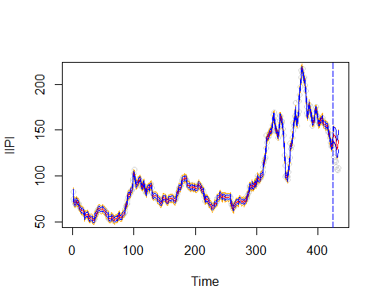
Harmonic Model (85)
This initial model with 85 harmonics significantly overfits the data.
Harmonic Model with 85 harmonics

Slide 38
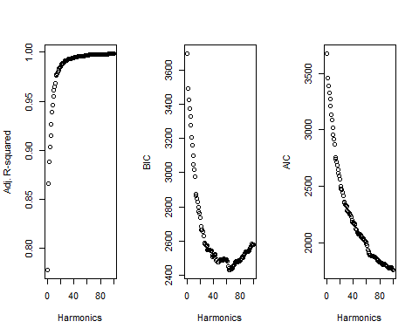
Harmonics vs. Fit Metrics
The model with 85 terms fits the in-sample data nearly perfectly (Adjusted R-squared: 0.9979). However, due to failure in the prediction region harmonic term reduction is investigated to assess if the predictive utility can be improved.
The three in-sample metrics are displayed as a function of increasing harmonics:

Slide 39
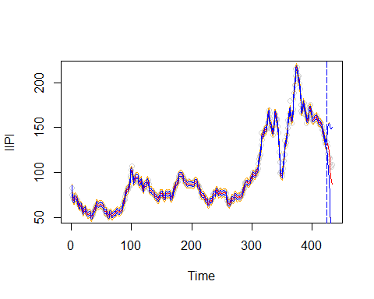
Harmonic Model (65)
AIC does not minimize in this region and adjusted R-squared continues to increase. BIC has a minimum at 65 harmonics. The following is the fit with 65 harmonics:
Harmonic Model with 65 harmonics

Slide 40
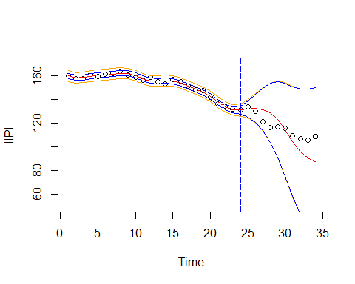
And the prediction region zoomed in for clarity:
Harmonic Model with 65 harmonics

Slide 41
Harmonic Model (15)

Slide 43
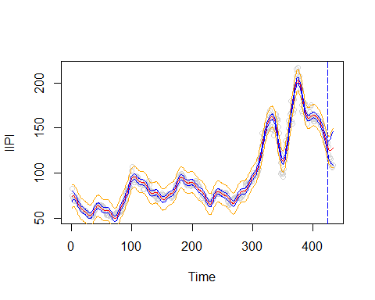
Harmonic Model (15)
## [1] "sin14" "cos12"
Harmonic Model with 15 Harmonics

Slide 44
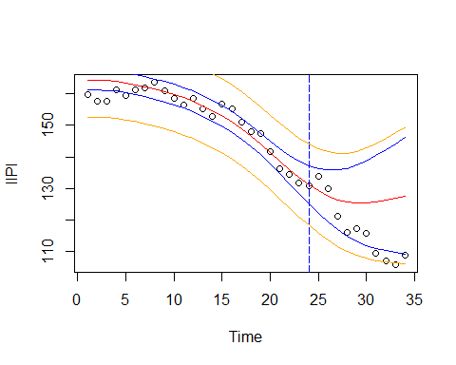
Harmonic Model with 15 Harmonics - Prediction Region

Slide 45
Harmonic Model Residual Assumptions

Slide 46
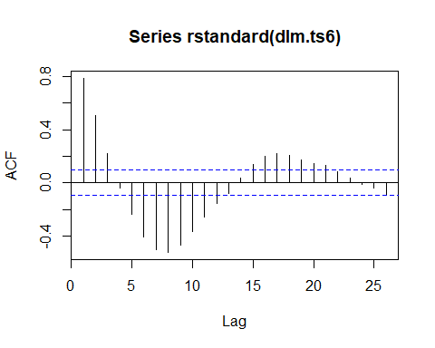
Harmonic Model Residual Autocorrelation
The Box-Pierce test is performed to identify if residuals are autocorrelated for the model with 15 harmonics (hypothesis defined above):
##
## Box-Pierce test
##
## data: rstandard(dlm.ts6)
## X-squared = 1074, df = 36, p-value < 2.2e-16
The residuals are stationary but not white noise, with fast sinusoidal decay.

Slide 47
Stochastic Models

Slide 48
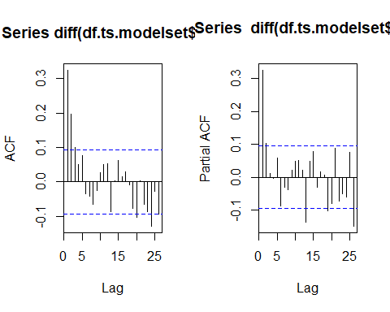
ARIMA Models
Next, Stochstic Models are estimated.
Before fitting a stochastic model the series must be stationary. IIPI is not stationary, but the first difference results in stationarity with sinusoidal decay, as seen above.
Having achieved stationarity, at the first difference, the ACF and PACF are reviewed to determine appropriate ARIMA model parameters:
In reviewing the ACF and PACF there are three proposed reasonable ARIMA models for investigation:
ARIMA(2,1,0) due to perceived cutoff of the PACF at 2, and interpretable sinusoidal decay of the ACF.
ARIMA(0,1,5) due to perceived cutoff of the ACF at 5, and interpretable sinusoidal decay of the PACF.
ARIMA(x,1,y) due to the perceived exponential decay of both ACF and PACF; $x,y=0,1,2$

Slide 49
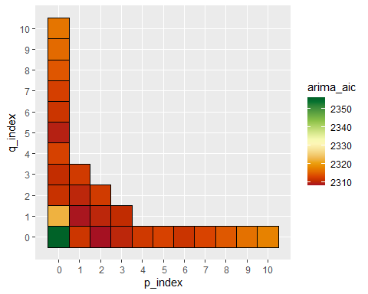
ARIMA model AIC Heatmap
This assessment is validated using a subset search of p and q values (ARIMA(p,1,q)). The resulting model AICs are displayed:

Slide 50
p_index | q_index | arima_aic
2 | 0 | 2307.985
1 | 1 | 2308.373
0 | 5 | 2309.411
The listed models resulted in the lowest AIC values, verifying the intuition and methodological approach:

Slide 51
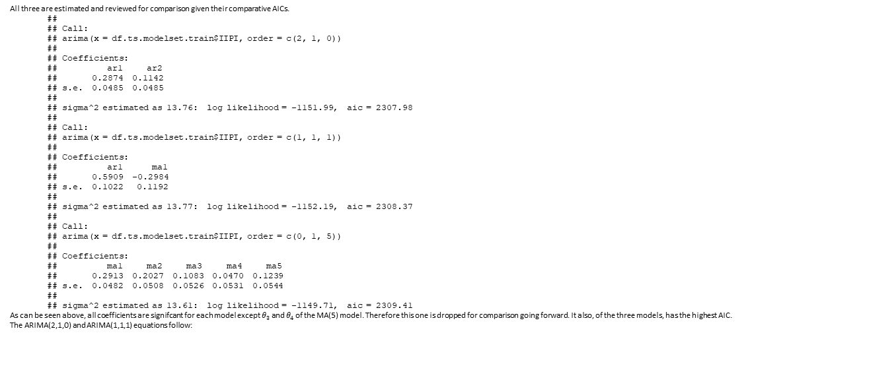
All three are estimated and reviewed for comparison given their comparative AICs.
##
## Call:
## arima(x = df.ts.modelset.train$IIPI, order = c(2, 1, 0))
##
## Coefficients:
## ar1 ar2
## 0.2874 0.1142
## s.e. 0.0485 0.0485
##
## sigma^2 estimated as 13.76: log likelihood = -1151.99, aic = 2307.98
##
## Call:
## arima(x = df.ts.modelset.train$IIPI, order = c(1, 1, 1))
##
## Coefficients:
## ar1 ma1
## 0.5909 -0.2984
## s.e. 0.1022 0.1192
##
## sigma^2 estimated as 13.77: log likelihood = -1152.19, aic = 2308.37
##
## Call:
## arima(x = df.ts.modelset.train$IIPI, order = c(0, 1, 5))
##
## Coefficients:
## ma1 ma2 ma3 ma4 ma5
## 0.2913 0.2027 0.1083 0.0470 0.1239
## s.e. 0.0482 0.0508 0.0526 0.0531 0.0544
##
## sigma^2 estimated as 13.61: log likelihood = -1149.71, aic = 2309.41
As can be seen above, all coefficients are signifcant for each model except $θ_{3}$ and $θ_{4}$ of the MA(5) model. Therefore this one is dropped for comparison going forward. It also, of the three models, has the highest AIC.
The ARIMA(2,1,0) and ARIMA(1,1,1) equations follow:

Slide 52
ARIMA(2,1,0):
$$z=IIPI_{t}−IIPI_{t−1}$$
$$z_{t}=φ_{1}z_{t−1}+φ_{2}z_{t−2}+ε_{t}$$

Slide 53
ARIMA(1,1,1):
$$z_{t}=φ_{1}z_{t−1}+ε_{t}−θ_{1}ε_{t−1}$$

Slide 54
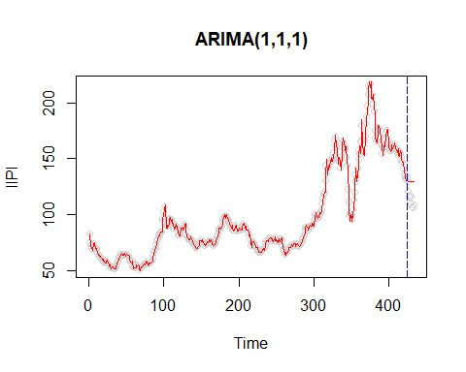
ARIMA Models Fit Plots
The model performs poorly when used to predict 10 values into the future.
ARIMA(2,1,0) Model with 20 step ahead predictions
However, when looking at sequential prediction, the model does incredibly well in the prediction region:
ARIMA(2,1,0) Model with sequential prediction
Similarly for ARIMA(1,1,1):
ARIMA(1,1,1) Model with 20 step ahead predictions

Slide 55
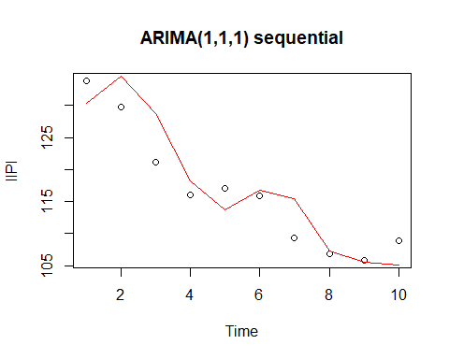
ARIMA(1,1,1) Model with sequential prediction

Slide 56
ARIMA Models Confirming White Noise
The residuals are reviewed for white noise.
##
## Box-Pierce test
##
## data: arima210$residuals
## X-squared = 28.268, df = 20, p-value = 0.1032
##
## Box-Pierce test
##
## data: arima111$residuals
## X-squared = 27.886, df = 20, p-value = 0.1121
Both are marginally white noise based on the above Box-Pierce tests. Success! But these models can be improved by stochastic residual correction outlined below.

Slide 57
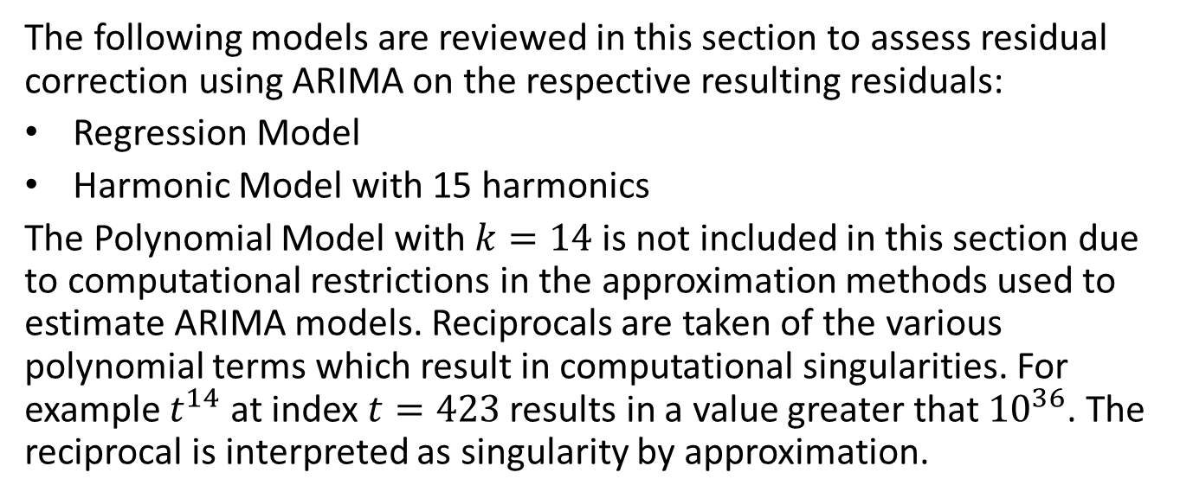
Stochastic Residual Corrections
The following models are reviewed in this section to assess residual correction using ARIMA on the respective resulting residuals:
Regression Model
Harmonic Model with 15 harmonics
The Polynomial Model with $k=14$ is not included in this section due to computational restrictions in the approximation methods used to estimate ARIMA models. Reciprocals are taken of the various polynomial terms which result in computational singularities. For example $t^{14}$ at index $t=423$ results in a value greater that ${10}^{36}$. The reciprocal is interpreted as singularity by approximation.

Slide 58
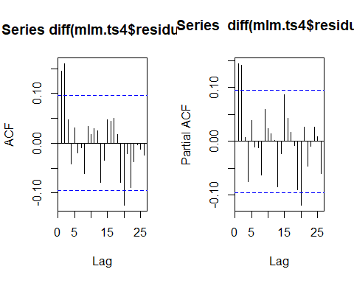
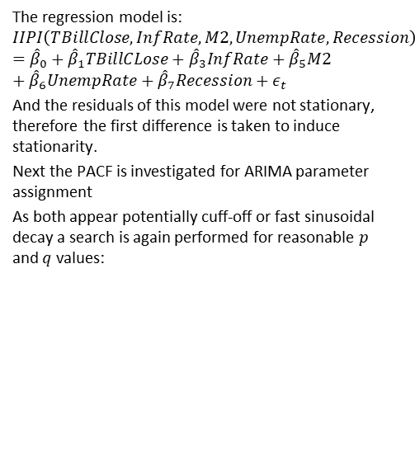
Stochastic Residual Correction for Regression Model
The regression model is:
$$IIPI\left(TBillClose,InfRate,M2,UnempRate,Recession\right)={\hat{β}}_{0}+{\hat{β}}_{1}TBillCLose+{\hat{β}}_{3}InfRate+{\hat{β}}_{5}M2+{\hat{β}}_{6}UnempRate+{\hat{β}}_{7}Recession+ε_{t}$$
And the residuals of this model were not stationary, therefore the first difference is taken to induce stationarity.
Next the PACF is investigated for ARIMA parameter assignment
As both appear potentially cuff-off or fast sinusoidal decay a search is again performed for reasonable $p$ and $q$ values:

Slide 59
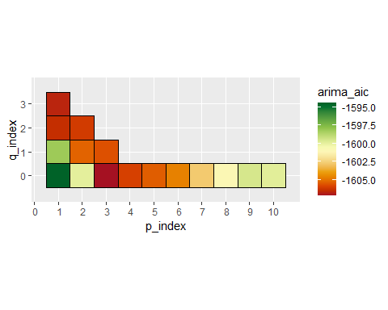
ARIMA model AIC Heatmap

Slide 60
p_index | q_index | arima_aic
3 | 0 | -1607.192
1 | 3 | -1606.707
1 | 2 | -1606.460
The minimum AIC occurs at $p=3$, $q=0$. Therefore an ARIMA(3,0,0) is fit to the residuals.

Slide 61
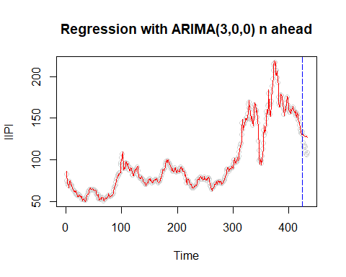
Stochastic Residual Correction Model Fit Plot
Again, n ahead performs poorly:
Regression with ARIMA(3,0,0) n ahead

Slide 62
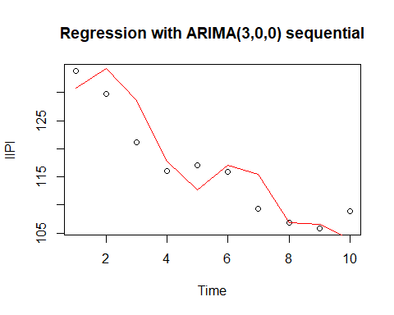
However as seen before, when looking at one step ahead prediction values, the prediction clearly performs much better:
Regression with ARIMA(3,0,0) sequential - prediction region

Slide 63
Stochastic Residual Correction Model Summary
##
## Call:
## arima(x = df.ts.modelset.train$IIPI, order = c(3, 0, 0), xreg = df.ts.modelset.train %>%
## select(-c("Date_form", "IIPI", "GDP", "IndPro")))
##
## Coefficients:
## ar1 ar2 ar3 intercept TBillClose InfRate M2
## 1.2594 -0.1352 -0.1282 110.3489 -0.0243 1.9988 -0.0036
## s.e. 0.0499 0.0802 0.0498 44.8738 0.3770 0.4747 0.0056
## UnempRate Recession
## -0.3204 0.7069
## s.e. 1.0666 1.1781
##
## sigma^2 estimated as 13.02: log likelihood = -1145.71, aic = 2309.42
All the regression coefficients become insignificant except the intercept and InfRate.

Slide 64
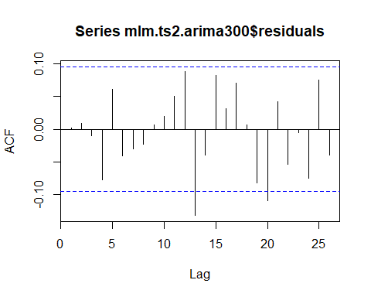
Stochastic Residual Correction Confirming White Noise
The residuals of the regression model with ARMIA residual correction are white noise.
##
## Box-Pierce test
##
## data: mlm.ts2.arima300$residuals
## X-squared = 0.0015202, df = 1, p-value = 0.9689

Slide 65
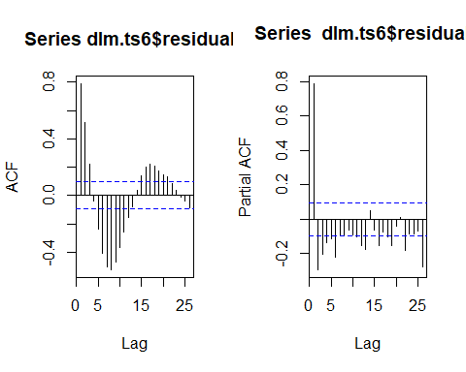
Stochastic Residual Correction for Harmonic Model
The harmonic model is ($i∈\{1:15\}$:
$$IIPI\left(t\right)={\hat{β}}_{0}+{\hat{β}}_{1}t+∑\hat{α_{i}}sin\left(\frac{2πi}{s}t\right)+∑{\hat{β}}_{i}cos\left(\frac{2πi}{s}t\right)+ε_{t}$$
First, as a reminder the residuals were very clearly auto-correlated, but already stationary.
The PACF is investigated to determine the appropriate ARIMA model.
Both the ACF and PACF do not have a clear cut-off, and could be interpreted as showing exponential decay. Expectation is therefore that an ARMA(p,q) with $p,q∉0$, will likely be applicable for the residual correction.

Slide 66
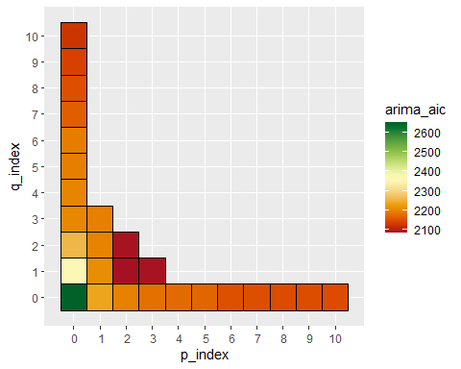
ARIMA Model AIC Heatmap

Slide 67
p_index | q_index | arima_aic
2 | 1 | 2084.413
2 | 2 | 2086.360
3 | 1 | 2086.366
As seen in the above chart ARIMA(2,0,1) best fits the residuals.

Slide 68
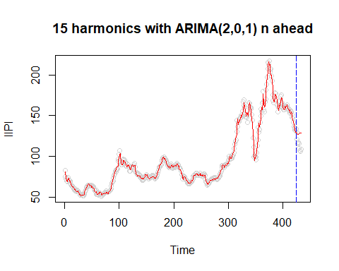
Stochastic Residual Correction Model Fit Plot
15 harmonics with ARIMA(2,0,1) n ahead

Slide 69
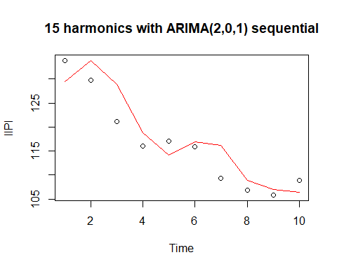
Again, as expected the n ahead prediction performs poorly.
… and the sequential prediction performs well.
15 harmonics with ARIMA(2,0,1) sequential

Slide 70
Stochastic Residual Correction Model Summary
Only one pair of harmonic terms (sin22 and cos22) have been made insignificant by this addition.
The AIC has been improved by correcting the residuals:
Harmonic Model: 2713.8738679
Harmonic Model with residual ARIMA correction: 2144.1014833
##
## Call:
## arima(x = df.ts.modelset.harmonic.train1$IIPI, order = c(2, 0, 1), xreg = df.ts.modelset.harmonic.train1 %>%
## select(-c("IIPI")))
##
## Coefficients:
## ar1 ar2 ma1 intercept index sin1 sin2 sin6
## 1.7269 -0.8581 -1.0000 71.7040 0.1193 -15.3773 -24.5896 1.6908
## s.e. 0.0247 0.0247 0.0059 7.1503 0.0336 4.6240 2.2943 0.7141
## sin8 sin7 sin11 sin3 sin5 sin9 sin4 sin12
## -1.6982 2.8785 3.5886 -4.3044 1.7513 -4.1149 -3.5399 3.1593
## s.e. 0.5206 0.6013 0.4106 1.5107 0.8745 0.4644 1.1145 0.4091
## sin13 sin10 sin14 sin22 cos1 cos2 cos6 cos8
## 2.6596 -2.2186 -0.1261 1.8673 18.2870 -6.5736 -8.3587 6.1522
## s.e. 0.4224 0.4284 0.4488 1.0322 0.2951 0.2968 0.3163 0.3355
## cos7 cos11 cos3 cos5 cos9 cos4 cos12 cos13
## 3.9142 -5.1365 -6.4572 -3.6219 3.3927 3.2029 0.5615 1.3448
## s.e. 0.3250 0.3818 0.2997 0.3093 0.3482 0.3038 0.4038 0.4302
## cos10 cos14 cos22
## -4.4217 2.0611 1.0904
## s.e. 0.3635 0.4617 1.0429
##
## sigma^2 estimated as 7.766: log likelihood = -1037.05, aic = 2144.1

Slide 71
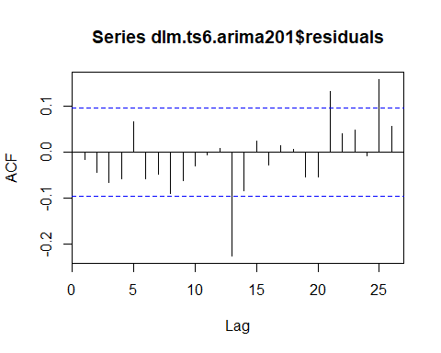
Stochastic Residual Correction Confirming White Noise
Despite the correction, residuals of the model do not result in white noise.
##
## Box-Pierce test
##
## data: dlm.ts6.arima201$residuals
## X-squared = 41.873, df = 20, p-value = 0.002873

Slide 72
Generalized Autoregressive conditionally Heteroscedastic Model (GARCH)
The following section investigates using GARCH. First, as shown before the series and its first difference are not white noise and therefore using GARCH on its own is not applicable. However, many of the previous models resulted in white noise residuals, and are investigated here.
The following models thus far have resulted in white noise residuals making them candidates for assessing utilization of GARCH:
ARIMA(2,1,0)
ARIMA(1,1,1)
Regression with ARIMA(3,0,0) on the residuals

Slide 73
ARIMA Models with (GARCH)

Slide 74
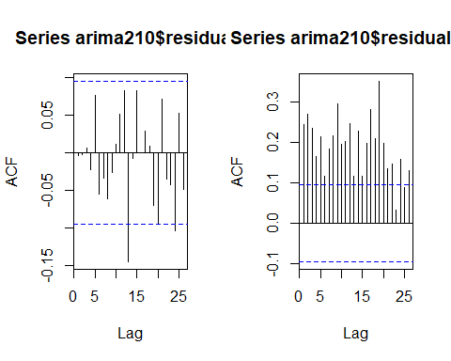
ARIMA(2,1,0) with GARCH
Residuals are first checked for GARCH model potential.
As can be seen the original ARIMA(2,1,0) model residuals are white noise, but the squared residuals are not. This is an excellent candidate for using GARCH!
##
## Box-Pierce test
##
## data: arima210$residuals
## X-squared = 0.0060746, df = 1, p-value = 0.9379
##
## Box-Pierce test
##
## data: arima210$residuals^2
## X-squared = 25.137, df = 1, p-value = 5.339e-07

Slide 75
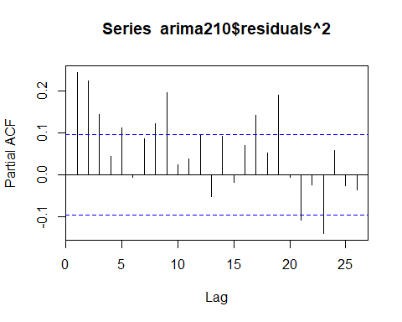
The PACF is displayed to investigate the possible GARCH order.

Slide 76
ARIMA(2,1,0) with GARCH Model Summary
As a model was not immediately obvious from the ACF and PACF, a appropriate GARCH model was found by estimating a diversity of GARCH parameters using the following search code:
p_index <- list()
q_index <- list()
d <- diff(df.ts.modelset.train$IIPI)
garch_list_2 <-
foreach(i=1:2) %:%
foreach(j=0:2) %do% {
garch_list<-garchFit(substitute(~arma(2,0)+garch(p,q),list(p=i,q=j)),data=d, trace=FALSE, include.mean = FALSE)
}
garch_list_2

Slide 77
ARIMA(2,1,0) with GARCH
##
## Title:
## GARCH Modelling
##
## Call:
## garchFit(formula = ~arma(2, 0) + garch(1, 1), data = diff(df.ts.modelset.train$IIPI),
## include.mean = FALSE, trace = FALSE)
##
## Mean and Variance Equation:
## data ~ arma(2, 0) + garch(1, 1)
## <environment: 0x00000000169d09b8>
## [data = diff(df.ts.modelset.train$IIPI)]
##
## Conditional Distribution:
## norm
##
## Coefficient(s):
## ar1 ar2 omega alpha1 beta1
## 0.20651 0.11658 0.18619 0.19309 0.80473
##
## Std. Errors:
## based on Hessian
##
## Error Analysis:
## Estimate Std. Error t value Pr(>|t|)
## ar1 0.20651 0.05502 3.754 0.000174 ***
## ar2 0.11658 0.05184 2.249 0.024515 *
## omega 0.18619 0.08213 2.267 0.023384 *
## alpha1 0.19309 0.04190 4.608 4.06e-06 ***
## beta1 0.80473 0.03506 22.956 < 2e-16 ***
## ---
## Signif. codes: 0 '***' 0.001 '**' 0.01 '*' 0.05 '.' 0.1 ' ' 1
##
## Log Likelihood:
## -1009.791 normalized: -2.39287
##
## Description:
## Sat Mar 05 17:30:59 2022 by user: nptho
The mean is removed from the model and all model parameters are significant.

Slide 78
ARIMA(2,1,0) with GARCH

Slide 79
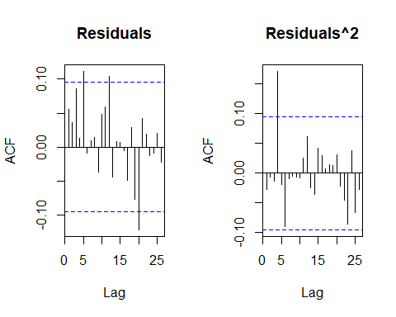
ARIMA(2,1,0) with GARCH White noise confirmation
The residuals and squared residuals of this model are white noise!
##
## Box-Pierce test
##
## data: arima210.garch11@residuals/arima210.garch11@sigma.t
## X-squared = 29.041, df = 20, p-value = 0.08696
##
## Box-Pierce test
##
## data: (arima210.garch11@residuals/arima210.garch11@sigma.t)^2
## X-squared = 20.888, df = 20, p-value = 0.4038

Slide 80
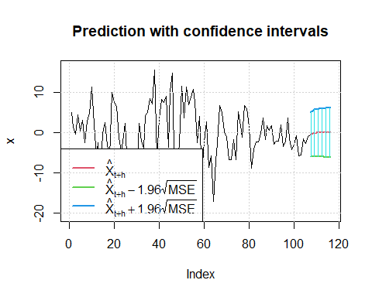
ARIMA(2,1,0) with GARCH Conditional Variance
The following is the predicted conditional variance of the IIPI first-difference:

Slide 81
## meanForecast meanError standardDeviation lowerInterval upperInterval
## 1 -0.5005337088 2.808713 2.808713 -6.005510 5.004442
## 2 -0.2046614643 2.897298 2.838642 -5.883262 5.473939
## 3 -0.1006184378 2.961455 2.868195 -5.904963 5.703726
## 4 -0.0446388731 2.993077 2.897384 -5.910962 5.821685
## 5 -0.0209488052 3.022984 2.926218 -5.945888 5.903991
## 6 -0.0095302912 3.052478 2.954710 -5.992277 5.973216
## 7 -0.0044103828 3.081624 2.982868 -6.044282 6.035462
## 8 -0.0020218620 3.110434 3.010702 -6.098361 6.094318
## 9 -0.0009317121 3.138919 3.038222 -6.153099 6.151236
## 10 -0.0004281234 3.167085 3.065435 -6.207801 6.206945

Slide 82
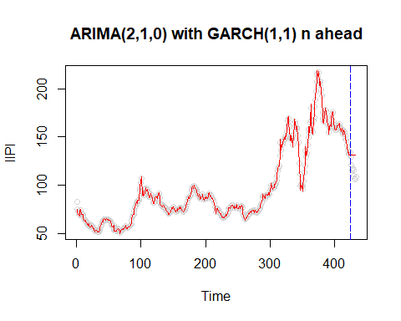
ARIMA(2,1,0) with GARCH Model Fit
As expected the n ahead prediction values tend toward the mean asymptotically:

Slide 83
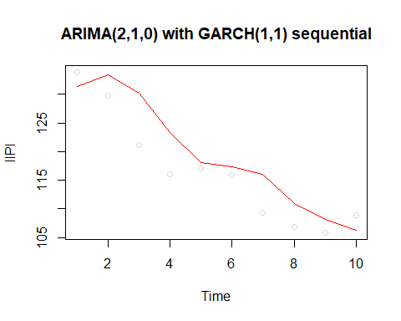
ARIMA(2,1,0) with GARCH Model Fit
When taking the predictions 1 step ahead, the model predicts well:

Slide 84
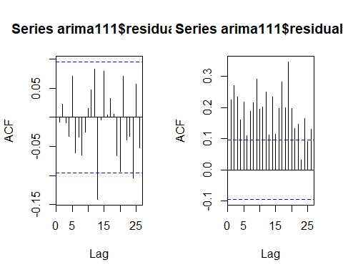
ARIMA(1,1,1) with GARCH
Residuals are first to checked for GARCH model potential.
As can be seen, again similar to the ARIMA(2,1,0) model, the ARIMA(1,1,1) residuals are white noise, but the squared residuals are not. This is an excellent candidate for using GARCH, again!
##
## Box-Pierce test
##
## data: arima111$residuals
## X-squared = 0.032177, df = 1, p-value = 0.8576
##
## Box-Pierce test
##
## data: arima111$residuals^2
## X-squared = 21.486, df = 1, p-value = 3.565e-06

Slide 85

ARIMA(1,1,1) with GARCH
The PACF is displayed to investigate the possible GARCH order.

Slide 86
ARIMA(1,1,1) with GARCH Model Summary
As a model was not immediately obvious from the ACF and PACF, a appropriate GARCH model was found by estimating a diversity of GARCH parameters using the following search code:
p_index <- list()
q_index <- list()
d <- diff(df.ts.modelset.train$IIPI)
garch_list_2 <-
foreach(i=1:2) %:%
foreach(j=0:2) %do% {
garch_list<-garchFit(substitute(~arma(1,1)+garch(p,q),list(p=i,q=j)),data=d, trace=FALSE, include.mean = FALSE)
}
garch_list_2

Slide 87
ARIMA(1,1,1) with GARCH(1,1)

Slide 88
##
## Title:
## GARCH Modelling
##
## Call:
## garchFit(formula = ~arma(1, 1) + garch(1, 1), data = diff(df.ts.modelset.train$IIPI),
## include.mean = FALSE, trace = FALSE)
##
## Mean and Variance Equation:
## data ~ arma(1, 1) + garch(1, 1)
## <environment: 0x0000000015b377c8>
## [data = diff(df.ts.modelset.train$IIPI)]
##
## Conditional Distribution:
## norm
##
## Coefficient(s):
## ar1 ma1 omega alpha1 beta1
## 0.57153 -0.35250 0.18164 0.19030 0.80761
##
## Std. Errors:
## based on Hessian
##
## Error Analysis:
## Estimate Std. Error t value Pr(>|t|)
## ar1 0.57153 0.11745 4.866 1.14e-06 ***
## ma1 -0.35250 0.13286 -2.653 0.00797 **
## omega 0.18164 0.07955 2.283 0.02241 *
## alpha1 0.19030 0.04057 4.690 2.73e-06 ***
## beta1 0.80761 0.03364 24.007 < 2e-16 ***
## ---
## Signif. codes: 0 '***' 0.001 '**' 0.01 '*' 0.05 '.' 0.1 ' ' 1
##
## Log Likelihood:
## -1009.899 normalized: -2.393125
##
## Description:
## Sat Mar 05 15:47:25 2022 by user: nptho
The insignificant mean is removed from the model and all other model parameters are significant.

Slide 89

ARIMA(1,1,1) with GARCH White noise confirmation
The residuals and squared residuals of this model are white noise!
##
## Box-Pierce test
##
## data: arima111.garch11@residuals/arima111.garch11@sigma.t
## X-squared = 28.11, df = 20, p-value = 0.1068
##
## Box-Pierce test
##
## data: (arima111.garch11@residuals/arima111.garch11@sigma.t)^2
## X-squared = 20.536, df = 20, p-value = 0.4249

Slide 90

ARIMA(1,1,1) with GARCH Conditional Variance
The following is the predicted conditional variance of the IIPI first-difference:

Slide 91
## meanForecast meanError standardDeviation lowerInterval upperInterval
## 1 -0.521679729 2.770328 2.770328 -5.951422 4.908063
## 2 -0.298155806 2.865052 2.800057 -5.913554 5.317242
## 3 -0.170405097 2.915818 2.829412 -5.885304 5.544493
## 4 -0.097391687 2.952409 2.858406 -5.884006 5.689223
## 5 -0.055662307 2.984202 2.887049 -5.904592 5.793267
## 6 -0.031812698 3.014213 2.915351 -5.939562 5.875936
## 7 -0.018181923 3.043419 2.943323 -5.983173 5.946809
## 8 -0.010391521 3.072142 2.970974 -6.031679 6.010896
## 9 -0.005939070 3.100493 2.998313 -6.082793 6.070915
## 10 -0.003394359 3.128513 3.025349 -6.135167 6.128379

Slide 92

ARIMA(1,1,1) with GARCH Model Fit
As expected the n ahead prediction value tends toward an asymptotic value:

Slide 93

ARIMA(1,1,1) with GARCH Model Fit
When taking the predictions 1 step ahead, the model predicts well:

Slide 94

Regression with ARMIA(3,0,0) on residuals and GARCH
Residuals are first checked for GARCH model potential.
As can be seen, similar to the ARIMA(2,1,0) and ARIMA(1,1,1) models, the residuals of the regression with ARIMA(3,0,0) residuals are white noise, but the squared residuals are not. This is again an excellent candidate for using GARCH!
##
## Box-Pierce test
##
## data: mlm.ts2.arima300$residuals
## X-squared = 0.0015202, df = 1, p-value = 0.9689
##
## Box-Pierce test
##
## data: mlm.ts2.arima300$residuals^2
## X-squared = 25.432, df = 1, p-value = 4.582e-07

Slide 95

Regression with ARMIA(3,0,0) on residuals and GARCH
The PACF is displayed to investigate the possible GARCH order.

Slide 96

Regression with ARMIA(3,0,0) with GARCH Model Summary
It appears that with inclusion of the GARCH on the residuals $φ_{2}$ and $φ_{3}$ and all the regressors are no longer significant. All GARCH coefficients are significant.

Slide 97

Regression with ARMIA(3,0,0) with GARCH Model Summary
As a model was not immediately obvious from the ACF and PACF, a appropriate GARCH model was assumed and estimated using the rugarch R library. NOTE: for this implementation of GARCH, fGARCH was not used, as it did not appear to allow for inclusion of external regression parameters:
p_index <- list()
q_index <- list()
d <- diff(df.ts.modelset.train$IIPI)
x <- df.ts.modelset.train[2:423,] %>% select(-IIPI,-Date_form,-GDP,-IndPro) %>% as.matrix()
spec = ugarchspec(mean.model = list(armaOrder = c(3, 0), external.regressors = cbind(x)))
fit = ugarchfit(spec = spec, data = d)
##
## *---------------------------------*
## * GARCH Model Fit *
## *---------------------------------*
##
## Conditional Variance Dynamics
## -----------------------------------
## GARCH Model : sGARCH(1,1)
## Mean Model : ARFIMA(3,0,0)
## Distribution : norm
##
## Optimal Parameters
## ------------------------------------
## Estimate Std. Error t value Pr(>|t|)
## mu 0.828213 1.044427 0.79298 0.427788
## ar1 0.182797 0.055661 3.28411 0.001023
## ar2 0.083830 0.055118 1.52091 0.128282
## ar3 0.025723 0.053817 0.47797 0.632669
## mxreg1 -0.130815 0.083281 -1.57076 0.116237
## mxreg2 -0.041577 0.095066 -0.43735 0.661856
## mxreg3 -0.000159 0.000117 -1.36175 0.173278
## mxreg4 0.108487 0.100599 1.07841 0.280851
## mxreg5 -0.438873 0.437626 -1.00285 0.315933
## omega 0.184981 0.079906 2.31499 0.020613
## alpha1 0.190621 0.040313 4.72852 0.000002
## beta1 0.805855 0.034369 23.44727 0.000000
##
## Robust Standard Errors:
## Estimate Std. Error t value Pr(>|t|)
## mu 0.828213 1.248895 0.66316 0.507230
## ar1 0.182797 0.055030 3.32174 0.000895
## ar2 0.083830 0.060353 1.38900 0.164834
## ar3 0.025723 0.056813 0.45277 0.650716
## mxreg1 -0.130815 0.081678 -1.60159 0.109246
## mxreg2 -0.041577 0.069099 -0.60171 0.547371
## mxreg3 -0.000159 0.000136 -1.16816 0.242742
## mxreg4 0.108487 0.112313 0.96594 0.334076
## mxreg5 -0.438873 0.377317 -1.16314 0.244771
## omega 0.184981 0.076488 2.41842 0.015588
## alpha1 0.190621 0.043850 4.34712 0.000014
## beta1 0.805855 0.030042 26.82431 0.000000
##
## LogLikelihood : -1007.778
##
## Information Criteria
## ------------------------------------
##
## Akaike 4.8331
## Bayes 4.9481
## Shibata 4.8315
## Hannan-Quinn 4.8785
##
## Weighted Ljung-Box Test on Standardized Residuals
## ------------------------------------
## statistic p-value
## Lag[1] 1.565 0.210940
## Lag[2*(p+q)+(p+q)-1][8] 6.202 0.005627
## Lag[4*(p+q)+(p+q)-1][14] 9.602 0.154639
## d.o.f=3
## H0 : No serial correlation
##
## Weighted Ljung-Box Test on Standardized Squared Residuals
## ------------------------------------
## statistic p-value
## Lag[1] 0.5128 0.47393
## Lag[2*(p+q)+(p+q)-1][5] 5.3330 0.12855
## Lag[4*(p+q)+(p+q)-1][9] 10.0431 0.04912
## d.o.f=2
##
## Weighted ARCH LM Tests
## ------------------------------------
## Statistic Shape Scale P-Value
## ARCH Lag[3] 0.133 0.500 2.000 0.715381
## ARCH Lag[5] 9.460 1.440 1.667 0.008899
## ARCH Lag[7] 12.041 2.315 1.543 0.006066
##
## Nyblom stability test
## ------------------------------------
## Joint Statistic: 1.8095
## Individual Statistics:
## mu 0.11850
## ar1 0.22650
## ar2 0.20195
## ar3 0.05323
## mxreg1 0.05848
## mxreg2 0.07864
## mxreg3 0.18389
## mxreg4 0.10377
## mxreg5 0.08529
## omega 0.05126
## alpha1 0.10927
## beta1 0.13580
##
## Asymptotic Critical Values (10% 5% 1%)
## Joint Statistic: 2.69 2.96 3.51
## Individual Statistic: 0.35 0.47 0.75
##
## Sign Bias Test
## ------------------------------------
## t-value prob sig
## Sign Bias 0.09473 0.9246
## Negative Sign Bias 0.82757 0.4084
## Positive Sign Bias 0.17236 0.8632
## Joint Effect 1.18575 0.7564
##
##
## Adjusted Pearson Goodness-of-Fit Test:
## ------------------------------------
## group statistic p-value(g-1)
## 1 20 22.64 0.2534
## 2 30 28.57 0.4877
## 3 40 33.92 0.7003
## 4 50 41.74 0.7594
##
##
## Elapsed time : 0.163841
To summarize the output above:
mxreg1 is through mxreg5 correspond to TBillClose, InfRate, M2, UnempRate, Recession
It appears that with inclusion of the GARCH on the residuals $φ_{2}$ and $φ_{3}$ are no longer significant, and the only significant regressor is again InfRate (as expected based on the regression with ARIMA(3,0,0) result). All GARCH coefficients are significant.

Slide 98

Regression with ARMIA(3,0,0) with GARCH White noise confirmation
Interestingly, residuals of this model would not be considered white noise.
##
## Box-Pierce test
##
## data: fit@fit$residuals
## X-squared = 31.46, df = 20, p-value = 0.0494

Slide 99

Regression with ARMIA(3,0,0) with GARCH Model Fit
As expected the n ahead prediction value tends toward an asymptotic value:

Slide 100

Regression with ARMIA(3,0,0) with GARCH Modle Fit
When taking the predictions 1 step ahead, the model performs much better, though not as well as the ARIMA models above:

Slide 101
Vector Autoregressive Moving Average
VARMA is used to estimate systems of time series data, allowing for concurent parameter estimation.
stationarity is induced in all variables by taking the first difference.
Recession is removed from the dataset as it is an indicator variable and is therefore not applicable in VARMA modelling.
All pair-wise cross-correlation functions (CCFs) are checked for bivariate white noise.
If one variable is found to be bivariate white noise with all others, it would be removed from the subsequent VARMA model.

Slide 102

Vector Autoregressive Moving Average CCFs

Slide 103

Vector Autoregressive Moving Average CCFs

Slide 104

Vector Autoregressive Moving Average CCFs

Slide 105

Vector Autoregressive Moving Average CCFs

Slide 106

Vector Autoregressive Moving Average CCFs

Slide 107

Vector Autoregressive Moving Average CCFs
M2 would be a candidate for removal from the VARMA except that it is not bivariate white noise with GDP. All others are clearly not bivariate white noise.

Slide 108
VAR(1) Model Estimation
 | IIPI | TBillClose | GDP | InfRate | IndPro | M2 | UnempRate
IIPI | 0.3005948 | 0.0062764 | 0.6331118 | 0.0097601 | 0.0216818 | -0.4756376 | -0.0035395
TBillClose | 0.4149962 | 0.2898252 | 2.8811548 | 0.0365280 | 0.1319462 | -2.3916959 | -0.0287407
GDP | 0.0008294 | 0.0006881 | -0.1430356 | 0.0005846 | 0.0016747 | -0.0187129 | -0.0003959
InfRate | 0.1565902 | -0.0341202 | 2.8613937 | 0.3723366 | 0.0760777 | -8.6053639 | -0.0048826
IndPro | 1.0920535 | -0.0029580 | 38.4951005 | 0.0275926 | 0.1319939 | 6.1424325 | -0.0769526
M2 | 0.0068815 | -0.0002027 | 0.4821545 | -0.0004496 | 0.0001455 | 0.4263939 | 0.0002248
UnempRate | 1.2035537 | -0.4594747 | 5.9520571 | -0.0053139 | -0.5185707 | 2.2371101 | 0.0096518
In consideration of computation time only VAR(1) model is estimated, with a matrix of 49 $φ$ estimates:
An interesting note: Industrial Production from the previous month has significant affect on the subsequent month’s GDP!

Slide 109
VAR(1) Parameter Significance
 | IIPI | TBillClose | GDP | InfRate | IndPro | M2 | UnempRate
IIPI | 6.2954218 | 1.1255351 | 0.8625932 | 2.0722417 | 3.4912181 | 0.9092890 | 1.6826953
TBillClose | 1.0736669 | 6.4293550 | 0.4851040 | 0.9591342 | 2.6274657 | 0.5655601 | 1.6898429
GDP | 0.2743562 | 1.9496803 | 3.0789594 | 1.9606739 | 4.2602952 | 0.5652120 | 2.9733342
InfRate | 0.3373553 | 0.6294744 | 0.4010733 | 8.1333096 | 1.2603479 | 1.6925581 | 0.2387558
IndPro | 2.9307513 | 0.0678201 | 6.7208944 | 0.7505189 | 2.7234662 | 1.5046711 | 4.6869664
M2 | 1.6798273 | 0.4238165 | 7.6571374 | 1.1126582 | 0.2731064 | 9.5013832 | 1.2456107
UnempRate | 1.0457814 | 3.4167056 | 0.3364158 | 0.0466863 | 3.4643665 | 0.1774486 | 0.1902881
Significnat if >1.96

Slide 110

VAR(1) Residual Assumptions
The vectors of residuals are not white noise:

Slide 111

VAR(1) Residual Assumptions

Slide 112

VAR(1) Model Fit of IIPI
IIPI exclusively, the model fit is nothing special when taken individually, but is useful in the generalization use case with many dependent variables of interest:

Slide 113
Prediction Comparison
Model | MAPE
ARIMA(0,1,5) seq. 1 ahead | 0.0279081
ARIMA(1,1,1) seq. 1 ahead | 0.0279240
ARIMA(2,1,0) seq. 1 ahead | 0.0283082
Regression, residual ARIMA(3,0,0), seq. 1 ahead | 0.0292654
Regression, residual ARIMA(3,0,0), GARCH(1,1), seq. 1 ahead | 0.0293076
Deterministic Model, 15 Harmonics, residual ARIMA, seq. 1 ahead | 0.0303350
AIMAA(2,1,0) with GARCH(1,1) seq. 1 ahead | 0.0349845
AIMAA(1,1,1) with GARCH(1,1) seq. 1 ahead | 0.0350633
Regression, residual ARIMA(3,0,0), GARCH(1,1), n ahead | 0.0727769
Deterministic Model, 65 Harmonics | 0.0787285
Deterministic Model, 15 Harmonics | 0.1030518
Deterministic Model, 15 Harmonics, residual ARIMA, n ahead | 0.1155852
Deterministic Model, 100 Harmonics | 0.1161898
Regression, residual ARIMA(3,0,0), n ahead | 0.1163019
ARIMA(0,1,5) n ahead | 0.1224968
ARIMA(1,1,1) n ahead | 0.1248374
ARIMA(2,1,0) n ahead | 0.1269807
VARMA prediction of IIPI | 0.1342517
ARIMA(2,1,0) with GARCH(1,1), n ahead | 0.1347798
ARIMA(1,1,1) with GARCH(1,1), n ahead | 0.1350159
Deterministic Model, 85 Harmonics | 0.1993137
Deterministic Model, Polynomial k=14 | 0.2574530
Deterministic Model, Monthly Indicator with Trend | 0.3107488
Regression Model, variable reduced | 0.5718380
The various models outlined above are compared using mean absolute percent error (MAPE). The 1 step sequential predictions out perform all other methods.

Slide 114
Transfer Function
In order to perform Transfer Function modelling:
pre-whitening must be performed on all the stationary independent variables.
this is accomplished using various ARIMA models on each independent variable.
for each independent variable first-differenced ACF and PACF are displayed, then used for assessment of potential ARIMA model, then white noise is verified using Box-Pierce:

Slide 115

TBillClose Pre-Whitening
An ARIMA(2,0,2) is used to pre-whiten the first-differenced TBillClose, and the resulting residuals can be seen to be white noise based on the Box-Pierce test.
##
## Call:
## arima(x = df.ts.modelset.train.vector.diff$TBillClose, order = c(2, 0, 2))
##
## Coefficients:
## ar1 ar2 ma1 ma2 intercept
## 0.6858 0.2417 -0.2088 -0.7912 -0.0262
## s.e. 0.0870 0.0871 0.0615 0.0614 0.0037
##
## sigma^2 estimated as 0.1791: log likelihood = -237.5, aic = 485.01
##
## Box-Pierce test
##
## data: arimaTBillClose$residuals
## X-squared = 0.17631, df = 1, p-value = 0.6746

Slide 116

GDP Pre-Whitening
An ARIMA(1,0,1) is used to pre-whiten the first-differenced TBillClose, and the resulting residuals can be seen to be white noise based on the Box-Pierce test.
##
## Call:
## arima(x = df.ts.modelset.train.vector.diff$GDP, order = c(1, 0, 1))
##
## Coefficients:
## ar1 ma1 intercept
## -0.0313 -0.1746 24.9658
## s.e. 0.1059 0.0947 2.2266
##
## sigma^2 estimated as 3263: log likelihood = -2305.86, aic = 4617.73
##
## Box-Pierce test
##
## data: arimaGDP$residuals
## X-squared = 0.0040854, df = 1, p-value = 0.949

Slide 117


InfRate Pre-Whitening
A SARIMA(2,0,0)(1,0,1)$​_{12}$ is used to pre-whiten the first-differenced InfRate, and the resulting residuals can be seen to be white noise based on the Box-Pierce test.
##
## Call:
## arima(x = df.ts.modelset.train.vector.diff$InfRate, order = c(2, 0, 0), seasonal = list(order = c(1,
## 0, 1), period = 12))
##
## Coefficients:
## ar1 ar2 sar1 sma1 intercept
## 0.5910 -0.0422 -0.0882 -0.8653 -0.0159
## s.e. 0.0493 0.0491 0.0578 0.0366 0.0046
##
## sigma^2 estimated as 0.07242: log likelihood = -54.28, aic = 118.55
##
## Box-Pierce test
##
## data: arimaInfRate$residuals
## X-squared = 0.0073331, df = 1, p-value = 0.9318

Slide 118

IndPro Pre-Whitening
An ARIMA(2,0,2) is used to pre-whiten the first-differenced IndPro, and the resulting residuals can be seen to be white noise based on the Box-Pierce test.
##
## Call:
## arima(x = df.ts.modelset.train.vector.diff$IndPro, order = c(2, 0, 2))
##
## Coefficients:
## ar1 ar2 ma1 ma2 intercept
## 1.5389 -0.6222 -1.4154 0.6264 0.1020
## s.e. 0.3547 0.3147 0.3247 0.2008 0.0582
##
## sigma^2 estimated as 0.2239: log likelihood = -283.27, aic = 576.54
##
## Box-Pierce test
##
## data: arimaIndPro$residuals
## X-squared = 0.078886, df = 1, p-value = 0.7788

Slide 119


M2 Pre-Whitening
A SARIMA(1,0,0)(1,0,0)$​_{12}$ is used to pre-whiten the first-differenced M2, and the resulting residuals can be seen to be white noise based on the Box-Pierce test.
##
## Call:
## arima(x = df.ts.modelset.train.vector.diff$M2, order = c(1, 0, 0), seasonal = list(order = c(1,
## 0, 0), period = 12))
##
## Coefficients:
## ar1 sar1 intercept
## 0.2894 0.6944 25.8303
## s.e. 0.0468 0.0353 5.6566
##
## sigma^2 estimated as 720: log likelihood = -1991, aic = 3988
##
## Box-Pierce test
##
## data: arimaM2$residuals
## X-squared = 3.2615e-05, df = 1, p-value = 0.9954

Slide 120

UnempRate Pre-Whitening
An ARIMA(2,0,2) is used to pre-whiten the first-differenced UnempRate, and the resulting residuals can be seen to be white noise based on the Box-Pierce test.
##
## Call:
## arima(x = df.ts.modelset.train.vector.diff$UnempRate, order = c(2, 1, 2))
##
## Coefficients:
## ar1 ar2 ma1 ma2
## -1.1607 -0.1907 0.2350 -0.7594
## s.e. 0.0594 0.0595 0.0425 0.0426
##
## sigma^2 estimated as 0.02607: log likelihood = 169.17, aic = -330.34
##
## Box-Pierce test
##
## data: arimaUnempRate$residuals
## X-squared = 8.2395e-05, df = 1, p-value = 0.9928

Slide 121

TF parameters
Next the CCFs are displayed to determine if any CCF indicate reasonable $b$, $r$, $s$ values:

Slide 122

CCF of IIPI, IndPro
ccf(df.ts.modelset.train.vector.prewhite$IIPI, df.ts.modelset.train.vector.prewhite$IndPro, ylab = "CCF", main = "IIPI,IndPro")

Slide 123

Transfer Function with IndPro
Taking IndPro as the transfer function predictor variable, and $b=1$, $r=1$, and $s=0$.
X_b1 <- df.ts.modelset.train.vector.prewhite$IndPro[1:422]- mean(df.ts.modelset.train.vector.prewhite$IndPro)
Y_b1 <- df.ts.modelset.train.vector.prewhite$IIPI[2:423] - mean(df.ts.modelset.train.vector.prewhite$IIPI)
The transfer function is estimated, forcing the residual correction to zero first to investigate:
m2<-arimax(Y_b1, order=c(1,0,0), fixed=c(0,NA,NA), xtransf=data.frame(X_b1), transfer=list(c(1,0)), include.mean = FALSE)

Slide 124

Transfer Function with IndPro
##
## Call:
## arimax(x = Y_b1, order = c(1, 0, 0), include.mean = FALSE, fixed = c(0, NA,
## NA), xtransf = data.frame(X_b1), transfer = list(c(1, 0)))
##
## Coefficients:
## ar1 X_b1-AR1 X_b1-MA0
## 0 0.6863 1.3059
## s.e. 0 0.0863 0.3232
##
## sigma^2 estimated as 14.74: log likelihood = -1163.79, aic = 2331.58
##
## Box-Pierce test
##
## data: m2$residuals
## X-squared = 34.423, df = 1, p-value = 4.436e-09

Slide 125

However, the residuals of the model are not white noise and seen in the above Box-Pierce and ACF. This is corrected using $ARIMA\left(1,0,1\right)$:
##
## Call:
## arimax(x = Y_b1, order = c(1, 0, 1), include.mean = FALSE, xtransf = data.frame(X_b1),
## transfer = list(c(1, 0)))
##
## Coefficients:
## ar1 ma1 X_b1-AR1 X_b1-MA0
## 0.5057 -0.2339 0.7202 0.9619
## s.e. 0.1268 0.1400 0.1175 0.3560
##
## sigma^2 estimated as 13.44: log likelihood = -1144.42, aic = 2296.84
##
## Box-Pierce test
##
## data: m2_arima11_resid$residuals
## X-squared = 0.0053907, df = 1, p-value = 0.9415
The transfer function model of IIPI using IndPro lagged by one month as predictor with ARIMA(1,0,1) correction on the residuals results in white noise. The model estimated is:
$$IIPI_{t}=\frac{ω_{0}}{1−δ_{1}B}IndPro_{t−1}+ε_{t}$$

Slide 126
Conclusion
The following Models resulted in white noise:
ARIMA(2,1,0)
ARIMA(1,1,1)
Regression with ARMIA(3,0,0)
ARIMA(2,1,0) with GARCH(1,1)
ARIMA(1,1,1) with GARCH(1,1)
TF IndPro b=2, r=1, s=0

Slide 127

Key project takeaways:
The choice of independent variables were unfortunately lacking in predictive value.
Harmonic models can be made to overfit in-sample, but as soon as prediction is involved, the bias-variance trade off has to be accounted for.
Inducing white noise using ARIMA could typically be accomplished using arbitrarily many p or q values but at the cost of more parameters to estimate, and compromise of model interpretability and parsimony.
N step ahead predictions are very poor typically beyond 1 step.
Sequential prediction (1 step ahead) is much better.
A transfer function with s and r equal to zero is simply a regression model. It was noted that inflation rate could have been used in transfer function modelling but the $s$ and $r$ parameters would have been zero, resulting in a trivial regression model.

